Slide 1
Air Quality Prediction:
U.S. Counties 2017-2019
DS5110 Semester Project
Daniel Heffley (dh3by)
Camille Leonard (cvl7qu)
Shah Shahrokhabadi (ss3qs)
Stephanie Verbout (sv8jy)

Slide 2
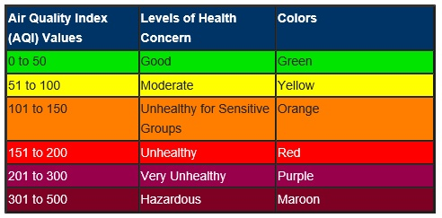
Executive Summary
Air Quality Index (AQI)
A daily measure of how polluted the air is in a certain jurisdiction
Research Questions
Can we use daily readings of gas, pollutant, particulate matter and meteorological data with socio-economic data to predict daily AQI?
Can we use gas, pollutant, particulate matter and meteorological data to predict median income?
Random Forest (RF) Regression and Gradient-Boosted Tree (GBT) Classifier
Predicted AQI extremely well
No model predicted median income adequately
Notes:
DH

Slide 3


Data Summary
Environmental Protection Agency (EPA)
Air Quality System (AQS) database
Supplemented by socio-economic data from OpenIntro
Response Variables
AQI and Median Income
Predictors
Daily readings from air quality monitors
Pollutant, gas, particulate matter and meteorological data
Population density and median income
Sampling
Taken from 2017-2019 EPA data, 2010 Census
Notes:
DH

Slide 4
Transformations/Preprocessing
Merge daily criteria gas, pollutant, meteorological, and AQI readings
Supplement with county-level socio-economic information
Median income
Population density
Dropped categorical variables and dates
Impute missing data for predictor columns with median and drop missing AQI values
‘Healthy’/’Unhealthy’ AQI binary indicator
Binary Logistic Regression and Gradient-Boosted Tree Classification
Standard Scaling
Scaled features for all models except Random Forest
Feature Indexer
For Random Forest Model

Slide 5
Model Development
10 Models total
Split 80% Training Data; 20% Holdout Data
Pipelines, Param Grid tuning, 5-fold Cross-Validation
Linear Regression, RF, Binary Logistic Regression, and GBT Classification
Baseline model included only criteria gas features (CO, SO2, NO2, O3)
Four models were fit with sets of criteria gas, pollutant, meteorological predictors and without socio-economic factors as predictors
Three models were fit with sets of criteria gas, pollutant, meteorological and socio-economic factors as predictors
Two models predicted median income with criteria gas, pollutant, meteorological, and population density predictors

Slide 6
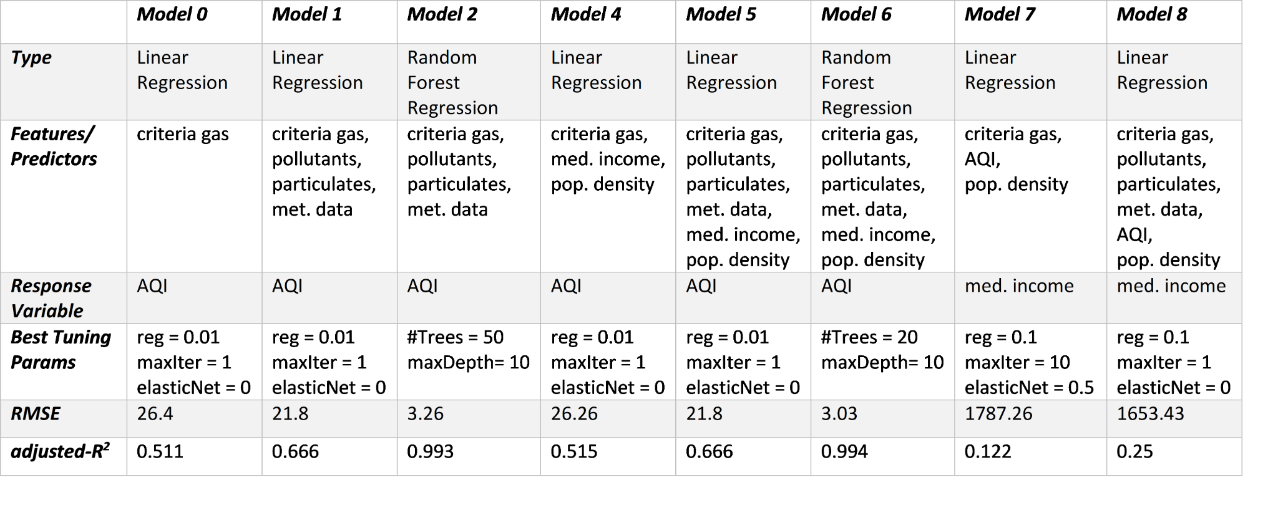
Model Performance
Linear Regression and Random Forest Models

Slide 7
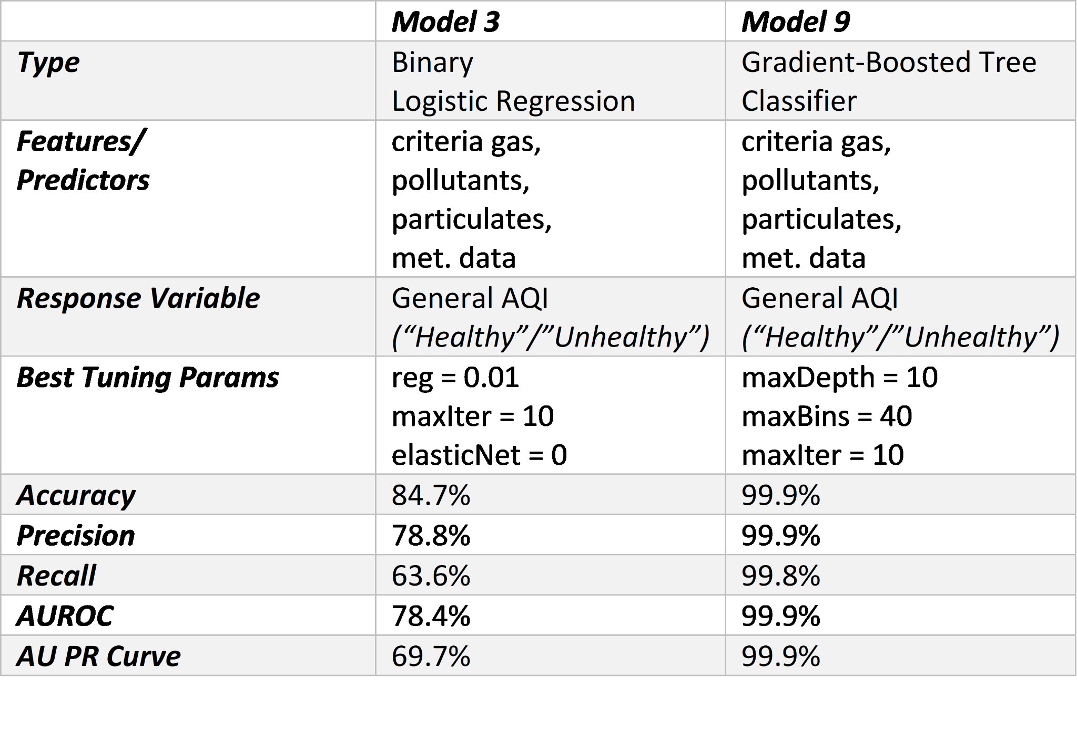
Model Performance
Binary Response Models

Slide 8
Conclusions
GBT Classifier and RF Regression
Very high performance in predicting AQI
Models did not predict median income accurately
Feature importance from RF model
particulate matter, ozone concentration, and temperature
Temperature is not considered in AQI calculations (AQI-technical manual, 2016)
Further point of research: temperature
Future use of model
Useful in cases where not all pollutant or gas data is available for certain sites
Future work
Test other methods: xgBoost, ensemble methods, other socio-economic factors

